Slide 1

Microsoft Credentials

Slide 2

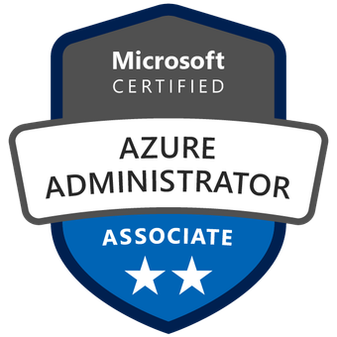
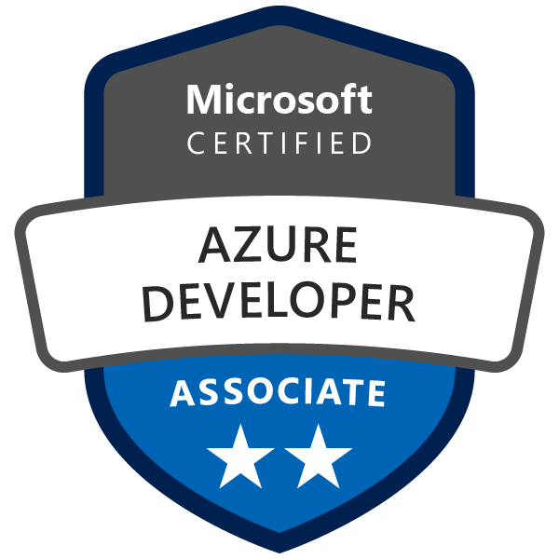


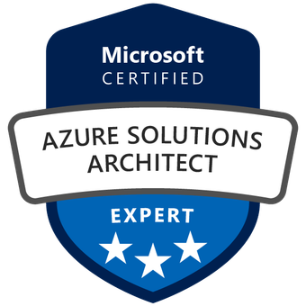

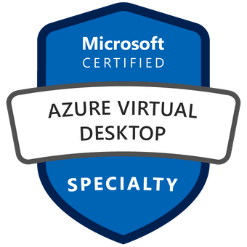
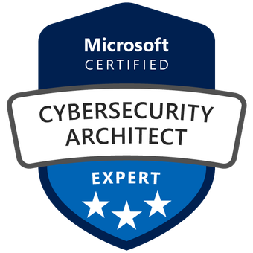
Hello!
Thank you for joining us today
Speaker: Luke Murray
Microsoft Learn Expert, Microsoft Azure MVP from Hamilton, New Zealand
https://x.com/lukemurraynz
https://bsky.app/profile/luke.geek.nz
https://www.linkedin.com/in/ljmurray/
https://luke.geek.nz/

Slide 3

IDC predicts that by 2027, 90% of organizations will feel the pain of the widening IT skills shortage, costing some $5.5 trillion globally in losses caused by product delays, impaired competitiveness, quality issues,
missed revenue goals, and declining customer satisfaction.
Organizational skill gaps are growing, too. To narrow the delta between the skills that companies need and the skills their people have, organizations must shift toward skills-based hiring and a way to validate those skills.
If there’s a silver lining, it’s that online training platforms and courses are increasingly popular, driven by remote and hybrid work realities.
Coupling full role-based credentials with scenario-based credentials can ensure that organizations have the necessary skills to remain competitive.
InfoBrief, sponsored by Microsoft
June 2024 | IDC #US52019124

Slide 4
Where to Start?
Security, cloud solutions, and AI are among the most in-demand skills. Respondents say they are also among the hardest to find and train for.
76%
Security (cybersecurity, DevSecOps)
65%
Cloud solutions and technologies (architecture, infrastructure, storage)
65%
Data (analysis, management, mining, visualization)
59%
Artificial intelligence (Al/Ml/GenAl)
55% Application development and testing (DevOps, programming)
49%
Internet of Things (connectivity, software development, system strategy)
48%
IT service management
46%
IT operations
34%
Business intelligence
InfoBrief, sponsored by Microsoft
June 2024 | IDC #US52019124

Slide 5

Credentials Matter
Organizations and their employees derive strong benefits from credentialing, whether it takes the form of full credentials or via micro-credentials.
How important is it that candidates for technical positions have credentials?
12%
Neither important nor unimportant
Not at all important
29%
Essential
More than 70% of organizations believe industry-recognized credentials are essential or very important tools
for skills training.
14%
Somewhat important
41%
Very important
InfoBrief, sponsored by Microsoft
June 2024 | IDC #US52019124

Slide 6



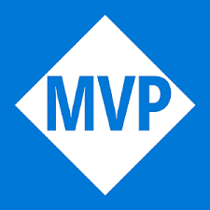
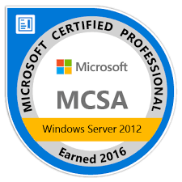

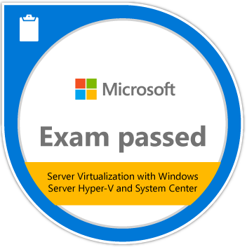
2022
Senior Consultant
2021
Technical Consultant
2017
Senior Engineer
2017
2013
2014
Technical Consultant
Service Desk
Enterprise Engineer (SysAdmin)
2002
IT Technician

Slide 7

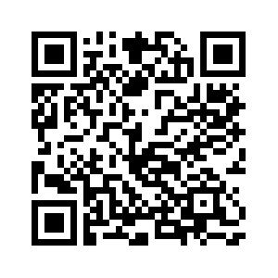
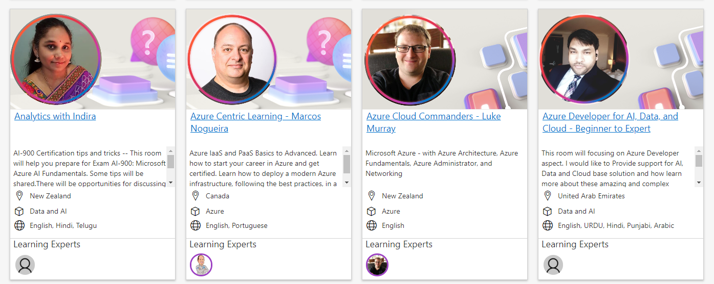
Azure Cloud Commanders
Microsoft Learning Room

Slide 8
Certificates have not only changed not only my career but also my life. Just getting the certs is not enough. You have to keep current and practice to stay relevant. Without all the work, certs are just "a piece of paper". And that's how it changed my life. I now read blogs, learn, whitepapers and books.
It helped me change my career to the Tech industry. That and a portfolio & blog.
It helps to proof to your potential employer you are qualified, but does not replace you showing that you’re qualified of delivering in the said position. That’s my opinion on certification, it’s a nice to have, but don’t stop there, keep on yourself in the new technologies.
Webinars are great, I attend as often as possible, it’s a good way to see the emerging trends in any industry.
Microsoft Learning Community
November 2024

Slide 9


Credential alternatives address goals, desired skills, and experience
Microsoft Applied Skills
Microsoft Certifications
Validates one specific skill
Validates broad technical proficiency
Goal
Project-based
Role-based
Context
Scenario-specific skills
Breadth of skills
Scope
Assessment via interactive lab experience
Exam with interactive elements
Format
On-demand
Scheduled
Flexibility

Slide 10
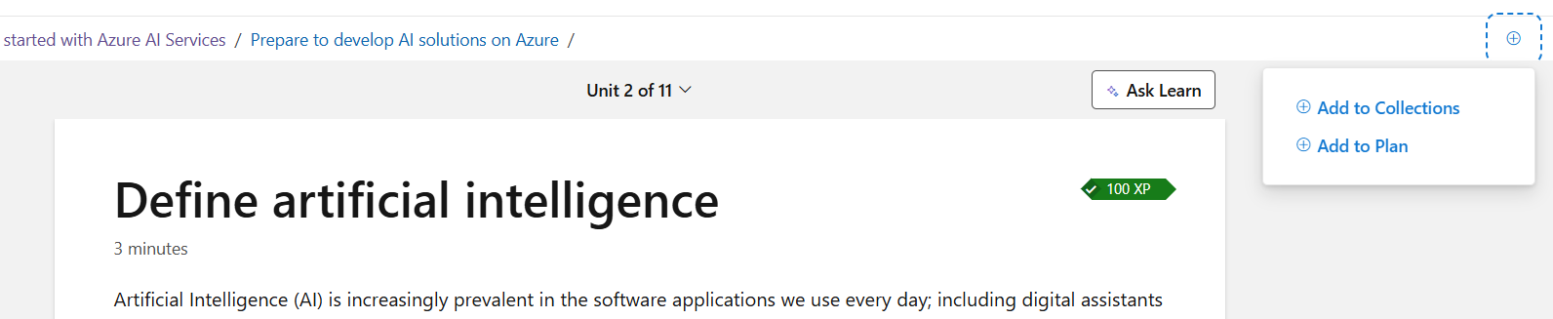
Microsoft Learn
Collections & Plans

Slide 11
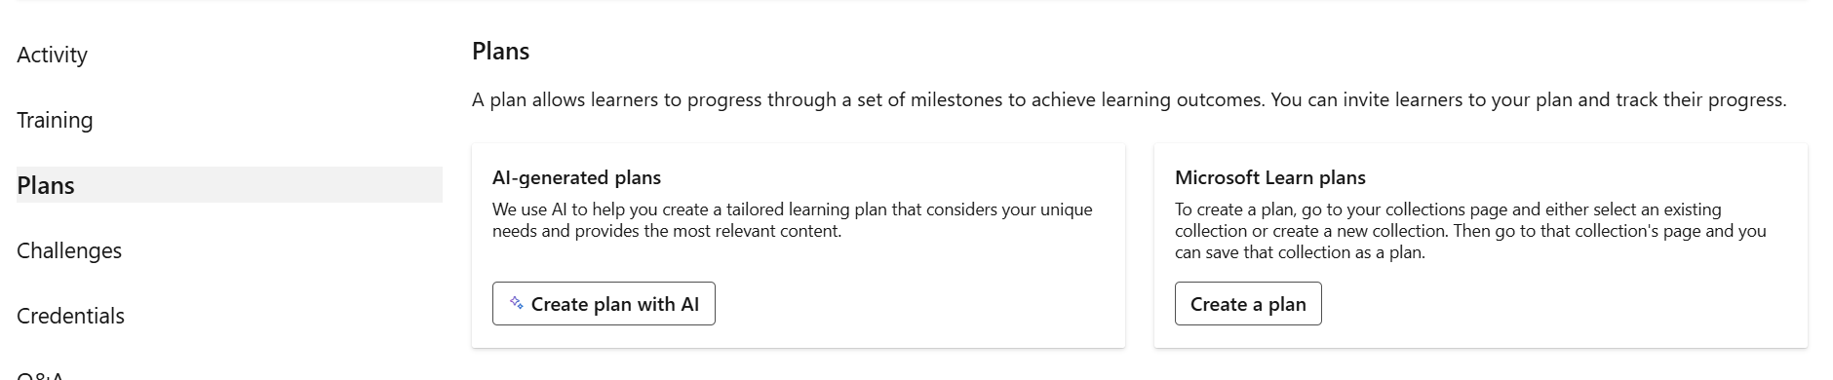
Microsoft Learn
Collections & Plans

Slide 12

Thank you
^ Social Media

Slide 13
Resources
Microsoft Learning Rooms
Microsoft Practice Assessments
Microsoft Learning (GitHub)
Exam Sandbox
What-the-Hack
Exam Readiness Zone
AWESOME-Azure-Architecture

Slide 14
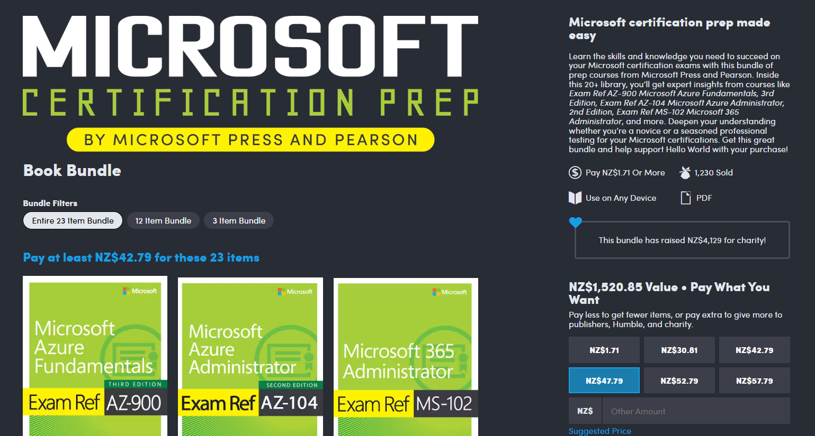
Humble Bundle
https://www.humblebundle.com/books/microsoft-certification-prep-microsoft-press-and-pearson-books

Slide 15
Skills readiness plan
Commoditized skills
Solution Manager
UI Designer UX Designer
Tester SDET
Developer
Application Operation & Support
Network Datacenter Engineer
Statistician Analyst
DBA Data Analyst
Relationship Manager
Trusted Advisor
Business Architect
Best use of assets
Process Engineer
Real-enough time
Engineering & DevOps
It works, build for monitoring self-healing
Edge/Wireless Networking
Secure, anywhere access
Cloud Architect
Secure, Anywhere access
Data Scientist
Business Insight
Information Architect
Trustworthy data
Strategic skills for the new era
1. Identify the gaps
2. Look across teams
3. Create an org-wide learning plan

Slide 16
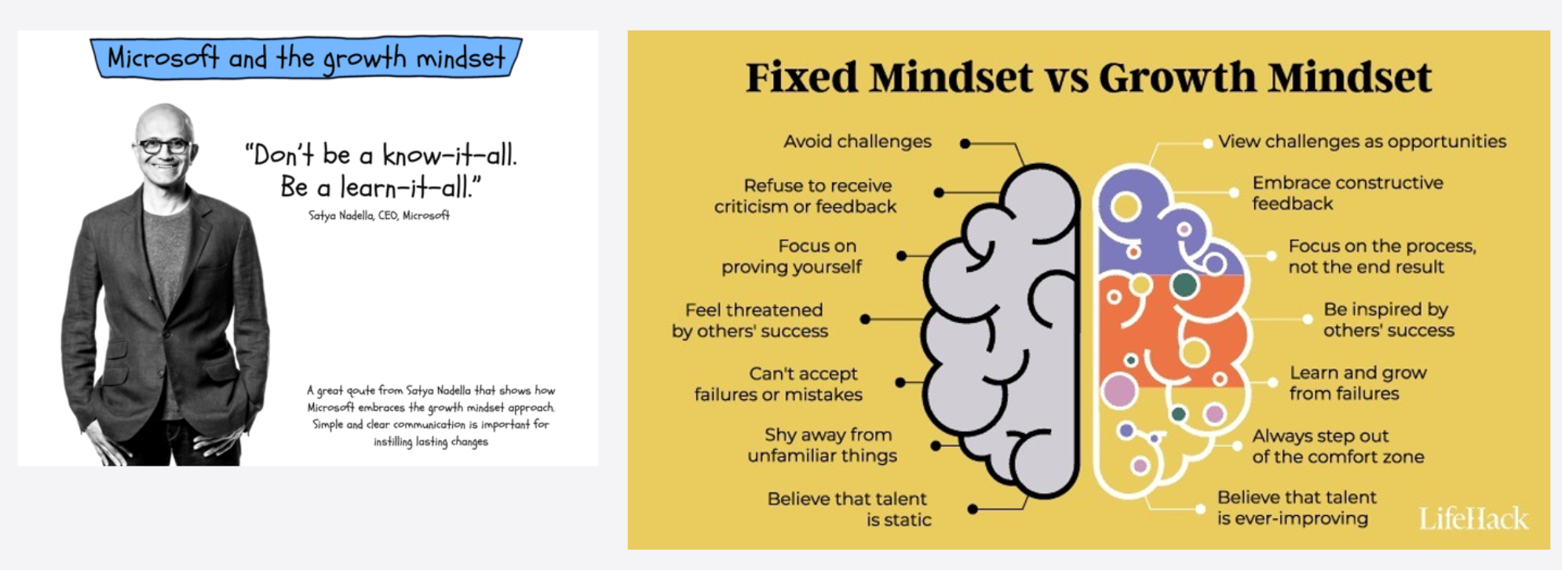

Slide 17


Slide 18
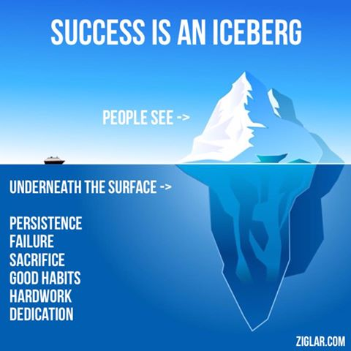
Goal
not role
Network with people around you
Passion
Network
Try learn
fail
Be
accountable

Slide 19
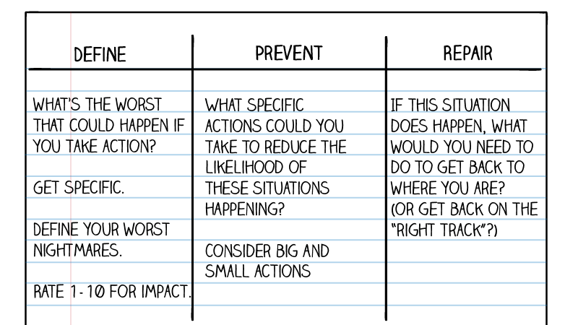
https://mindfulambition.net/fear-setting-tim-ferriss/

Slide 20

Microsoft Skilling Universe
No cost
Fee-based
How do your learners prefer to learn?
Choose the right skilling approach for your team. Click any tile to learn more.
Skills readiness plan
I want to assess where my skill level is
Provide skilling
recommendations
Practice Assessments
Learning Partners
Connected Learning Experience (CLX)
I want to learn on my own time
Self-paced content
Self-paced learning
Documentation
LinkedIn Learning
Connected Learning Experience (CLX)
I want to watch and learn from others
On-demand video
Shows
LinkedIn Learning
I want live feedback
Instructor-led
Instructor-led training
Microsoft Virtual Training Days
Learning Partners
Blended Learning
Azure Technical Skilling Workshops
I want to learn in a fun way
Gamified
Cloud Games
Cloud Skills Challenge
30 Days to Learn It
I want an interactive experience
Interactive learning
Cloud Workshops
Blended Learning
Azure Technical Skilling Workshops
Events
I want to prepare for a certification
Preparation
Exam readiness
Practice Assessments
Learning Partners
I want to validate my knowledge
Credentials
Certifications
I want to connect/learn from others
Community
Microsoft Learn Community
Q&A
I want a programmatic experience
Programs
Enterprise Skilling Initiative
Unified Workshops
Connected Learning Experience (CLX)
I want to accelerate my organizations digital transformation
Hub for innovation
MTC

Slide 21
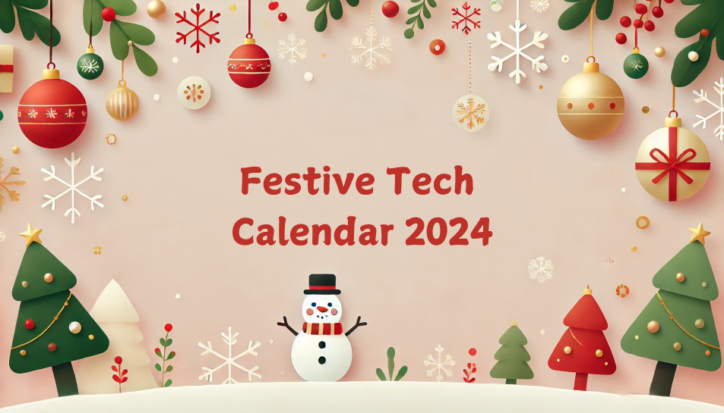
https://www.festivetechcalendar.com/

Slide 22

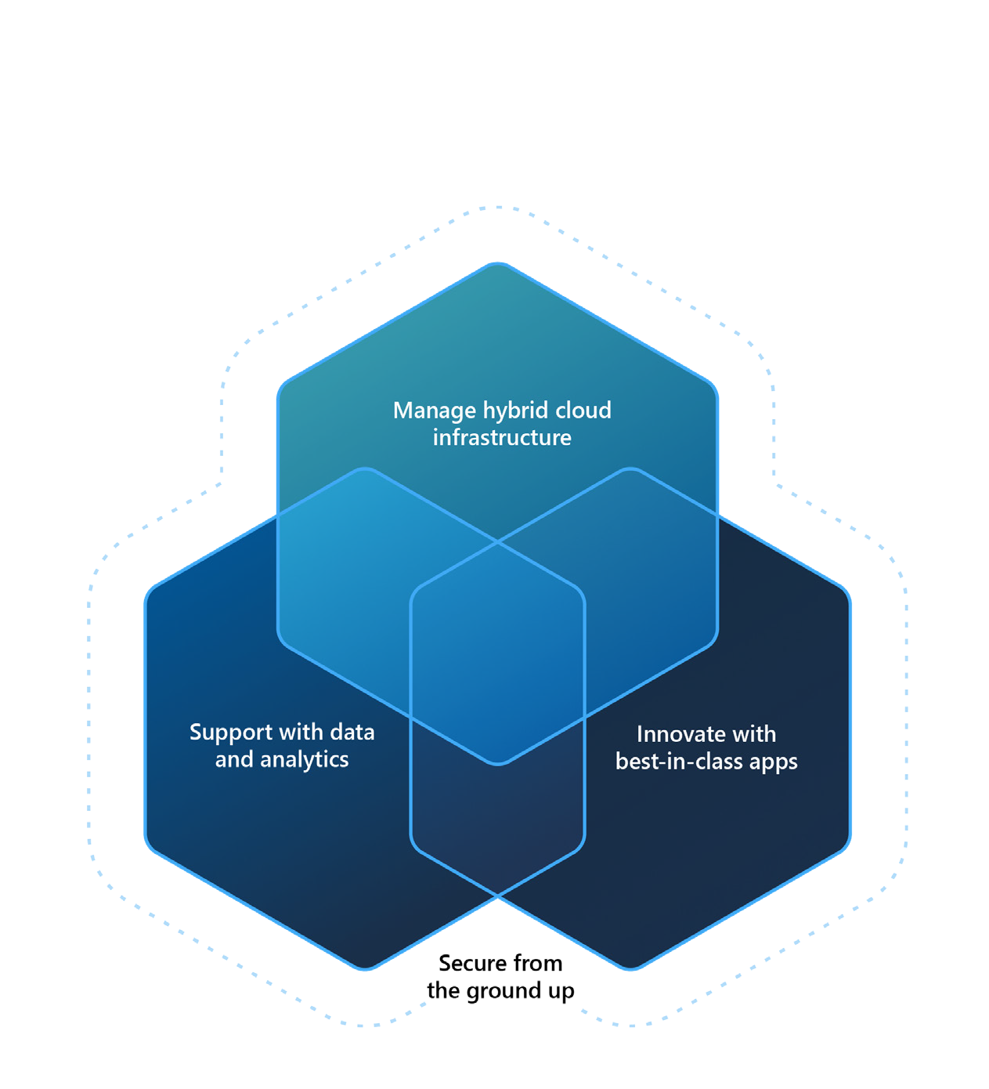
Introduction
Sharpening your team’s cloud skills begins here
Achieve your goals with the freedom and flexibility to build, manage, and deploy your applications anywhere. Use your preferred languages, frameworks, and infrastructure—even your own data center and other clouds—to solve challenges large and small. With help from Microsoft Azure, you have everything you need to build your next great solution.
Microsoft Learn supports IT pros, developers, and data and AI professionals to get the skills they need to cover all the aspects of digital transformation— managing on-premises, hybrid, or cloud infrastructure; innovating with the best-in class applications; and supporting apps and infrastructure with data and analytics, all with the proper security considerations.
The right journey leads to long-term growth
A map for the next milestone
Use this guidebook to discover the recommended journey for you or your team. The following pages describe the recommended tracks learners can take o receive the maximum benefits of Azure training and certification.
Master the basics and beyond
Each journey is designed to help managers and learners identify where to start and where to go based on their specific role or projects.
Everything you need in one place
After determining which journey is the right fit, find courses, training opportunities, and other important information that sets you or your team up for success.
IT pros
Developers
Data & AI pros

Slide 23

























Master the basics
Instructor-led | Self-paced | Microsoft Virtual | Exam | Microsoft Official | Microsoft | Microsoft Learn
training | learning | Training Days | preparation | Practice Test | Certifications | Cloud Games
Cloud IT pros
Hybrid cloud IT pros
Developers
Data & AI professionals
Data analysts
New to the cloud or new to Azure
Azure fundamentals
Recommended for these roles
Course AZ-900
Exam AZ-900
New to Azure administration
Prerequisites for Azure administrators
Prerequisites for Azure administrators
Course AZ-104
New to data solutions on Azure
Azure data fundamentals
Course DP-900
Exam DP-900
New to AI or new to AI on Azure
Azure AI fundamentals
Course AI-900
Exam AI-900
New to Microsoft Power Platform
Power Platform fundamentals
Course PL-900
Exam PL-900

Slide 24
















Training journey for cloud IT pros
Grow in role
Instructor-led | Self-paced | Microsoft Virtual | Exam | Microsoft Official | Microsoft | Microsoft Learn
training | learning | Training Days | preparation | Practice Test | Certifications | Cloud Games
Start here
Choose additional paths that best fit your role and projects
Implement and manage secure cloud solutions
Azure administrator
Implement and manage secure cloud solutions
Azure security engineer
Bring cloud agility on-premises
Azure Stack Hub operator
Course AZ-104
Exam AZ-104
Course AZ-500
Exam AZ-500
Course AZ-600
Exam AZ-600
Manage SAP solutions on Azure
Azure for SAP workloads
Deliver virtual desktop experiences and remote apps on Azure
Azure Virtual Desktop administrator
Course AZ-120
Exam AZ-120
Course AZ-140
Exam AZ-140
Implement and manage networking solutions
Azure network engineer
Troubleshoot networking and connectivity issues in Azure
Azure support engineer for connectivity
Course AZ-700
Exam AZ-700
Exam AZ-720
Want to keep learning?
Check out the Security, Compliance, and Identity Training Journey

Slide 25

Training journey for hybrid cloud IT pros
Grow in role
Instructor-led | Self-paced | Microsoft Virtual | Exam | Microsoft Official | Microsoft | Microsoft Learn
training | learning | Training Days | preparation | Practice Test | Certifications | Cloud Games
Start here
Choose additional paths that best fit your role and projects
Manage Windows Server on-premises, hybrid, and IaaS platform workloads
Windows Server hybrid administrator
Implement, manage, and monitor cloud solutions
Azure administrator
Course AZ-800
Exam AZ-800
Course AZ-104
Exam AZ-104
Course AZ-801
Exam AZ-801
Deliver virtual desktop experiences and remote apps on Azure
Azure Virtual Desktop administrator
Course AZ-140
Exam AZ-140
Manage on-premises hyper-converged environments with Azure Stack HCI
Course WS-013

Slide 26

Training journey for cloud IT pros expert level
Grow in role
Instructor-led | Self-paced | Microsoft Virtual | Exam | Microsoft Official | Microsoft | Microsoft Learn
training | learning | Training Days | preparation | Practice Test | Certifications | Cloud Games
Start here
Implement, manage, and monitor cloud solutions
Azure administrator
Choose additional paths that best fit your role and projects
Deliver continuous value integrating people, processes, and technologies
DevOps engineer
Course AZ-104
Exam AZ-104
Course AZ-400
Exam AZ-400
Design and implement end-to-end cloud solutions
Azure solutions architect
Course AZ-305
Exam AZ-305

Slide 27








Training journey for developers
Grow in role
Instructor-led | Self-paced | Microsoft Virtual | Exam | Microsoft Official | Microsoft | Microsoft Learn
training | learning | Training Days | preparation | Practice Test | Certifications | Cloud Games
Start here
Choose additional paths that best fit your role and projects
Design, build, test, and maintain cloud apps
Azure developer
Build, manage, and deploy AI solutions
Azure AI engineer
Deliver continuous value integrating people, processes, and technologies
DevOps engineer
Course AZ-204
Modernize apps
Course AI-102
Exam AI-102
Course AZ-400
Exam AZ-400
Exam AZ-204
Cloud native apps
Develop cloud and edge IoT solutions
Azure IoT developer
Migrate data to the cloud
Course AZ-220
Exam AZ-220
Course DP-050
Migrate infra & data
Course DP-060
Migrate OSS DB
Develop cloud-native apps that store and manage data
Azure Cosmos DB developer
Course DP-070
Course DP-420
Exam DP-420
Want to keep learning?
Check out the Power Platform Training Journey

Slide 28


Training journey for data & AI professionals
Grow in role
Instructor-led | Self-paced | Microsoft Virtual | Exam | Microsoft Official | Microsoft | Microsoft Learn
training | learning | Training Days | preparation | Practice Test | Certifications | Cloud Games
Start here
Choose additional paths that best fit your role and projects
Manage relational cloud and hybrid databases
Azure database administrator
Deliver continuous value integrating people, processes, and technologies
Azure data engineer
Build, train, and deploy machine learning models
Azure data scientist
Course DP-300
Exam DP-300
Course DP-203
Exam DP-203
Course DP-100
Exam DP-100
Course DP-090
Exam DP-090
Migrate data to the cloud
Course DP-050
Migrate infra & data
Course DP-060
Migrate OSS DB
Course DP-070

Slide 29

Training journey for data analysts
Grow in role
Instructor-led | Self-paced | Microsoft Virtual | Exam | Microsoft Official | Microsoft | Microsoft Learn
training | learning | Training Days | preparation | Practice Test | Certifications | Cloud Games
Start here
Maximize the value of data assets with advanced analytics
Power BI data analyst
Build enterprise-scale data analytics solutions
Azure Enterprise data analyst
Course PL-300
Exam PL-300
Course DP-500
Exam DP-500

Slide 30


Microsoft Virtual Training Day events
These are in-depth, virtual training events that guide you toward the many possibilities for career and organizational impact today and tomorrow. With weekly events to match every skill level, they offer an opportunity to grow your technical skills and to gain the confidence to navigate what’s ahead.
Microsoft Azure Virtual Training Days
Azure Fundamentals > aligned to Exam AZ-900 skills
Azure AI Fundamentals > aligned to Exam AI-900 skills
Azure Data Fundamentals > aligned to Exam DP-900 skills
Modernize .NET Apps > recommended for Azure developers
Linux OSS Database Migration > recommended for Azure database administrators
Migrating On-Premises Infrastructure and Data
recommended for Azure database administrators
Azure Virtual Desktop
recommended for Azure Virtual Desktop administrators
DevOps with GitHub > recommended for DevOps engineers
Well-Architected > recommended for Azure solution architects
Deliver Integrated Analytics with Azure Synapse
recommended for Azure data engineers
Implementing Hybrid Infrastructure
recommended for Windows Server hybrid administrators
Cloud Native Apps > recommended for Azure developers
 Find and register for Microsoft Azure Virtual Training Days

